Slide 2
Objectives
Describe the features of different mobile devices
List the different types of platforms available for mobile devices
Explain the design and architectural aspects of a mobile Web site
Explain the requirements for developing and testing of a mobile Web site
Explain HTML5 support for a mobile Web site
List the best practices for optimizing a mobile Web site

Slide 3
Mobile Application Environment
Today, access to the Web is not limited to only desktop systems, but is also available on portable and wireless devices, such as mobiles devices.
A mobile device, also known as a handheld device, is a small portable computing device with a small display screen and keyboard.
A mobile device has an operating system on which various types of application software are executed.
These application software are also known as apps.
The most commonly used apps are mobile browsers that display the Web pages.

Slide 4
Types of Mobile Devices
The different categories of mobile phones available in the market are:
Low-end Mobile Devices
Mid-end Mobile Devices
High-end Mobile Devices
Tablets and Notebooks
Smartphones

Slide 5
Mobile Platforms 1-2
A mobile device platform is similar to a software platform.
It is responsible to interact with the device hardware and run software/services on the mobile device.
The mobile platforms are categorized as proprietary & open source.
Palm OS
It is a proprietary mobile OS developed by Palm Inc. and was used for Personal Digital Assistants (PDAs).
Blackberry OS
Currently, Palm Inc. has developed webOS, which is based on the Linux kernel.
It is a proprietary mobile OS developed by Research in Motion (RIM) and is based on Java platform.
It is primarily used by Blackberry smartphone devices.

Slide 6
Mobile Platforms 2-2
Windows Mobile
runs on top of the Windows Mobile platform.
Android
Linux
open source OS, supported by Motorola smartphones.
open source OS developed by Google, currently used by smartphones and tablet computers.
iOS
developed by Apple Inc. and was initially referred to as iPhone OS.
derived from Mac OS X, which is based on the UNIX platform.
Symbian
open source mobile OS developed for mobile phones.
includes a user interface framework, libraries, and component tools.

Slide 7
Design Aspects of Mobile Web Site 1-3
Basic considerations for designing a mobile web sites are as follows:
Resolution and Physical Dimension
Page Orientation
Input methods
Resolution and Physical Dimension
The resolution means the number of pixels (width and height) on the screen: Pixels per Inch (PPI) or Dots per Inch (DPI)
Following table lists the resolutions of mobile devices based on their categories.
Category | Resolutions (in pixels)
Low-end mobile devices | 128 x 160 or 128 x 128
Mid-end mobile devices | 176 x 220 or 176 x 208
High-end devices | 240 x 320
Smartphones | 240 x 480, 480 × 320, 640 × 480, or 960 × 640

Slide 8
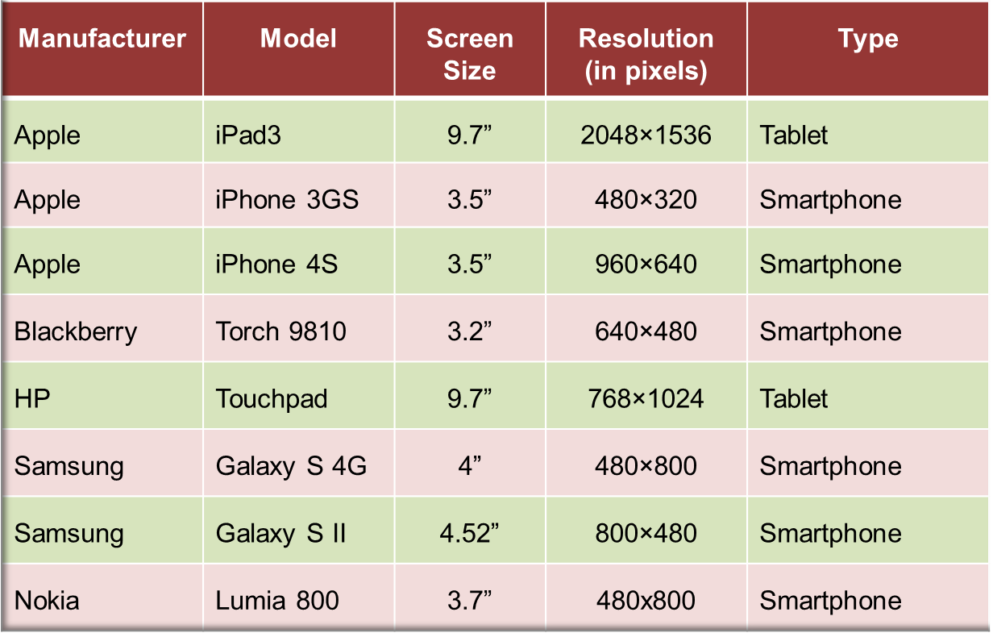
Design Aspects of Mobile Web Site 2-3
Following table lists the resolution and display sizes of different mobile devices.
The mobile devices are also categorized based on their orientation, vertical and horizontal.

Slide 9
Design Aspects of Mobile Web Site 3-3
Smartphones and tablets can switch between landscape and portrait views to present the better viewing of a Web page.
This rotation capability of changing the view from landscape to portrait or vice-versa is due to the hardware accelerators available in the phones.
A mobile Web site must be aware of these rotations and should provide a good user experience in both the orientations.
Input Methods
Numeric keypad
Alphanumeric keypad (Simple or QWERTY)
Virtual keypad on screen
Multi-touch
External keypad
Voice and handwriting recognition

Slide 10
Architectural Aspects 1-2
Navigation
Navigation is the path followed by a user to travel in a Web site.
As compared to the navigation tree of a desktop site, almost 80% of the information of a desktop site will not be useful to a mobile Web site.
Thus, the main focus should be on 20%.
Perspective
The perspective of a mobile user is different from a desktop user in terms of needs and accessibility.
Hence, a user-centric design approach should be followed for designing mobile Web sites.
This ensures that a user completes the task easily and successfully.
Enhancement
Enhancement is a simple and powerful technique that can be adopted while designing a mobile Web site.
This technique defines compatibility of Web site and allows access to basic content, services, and functionality on all type of mobile devices.
Also, it provides a better Web experience on devices with higher standards.

Slide 11
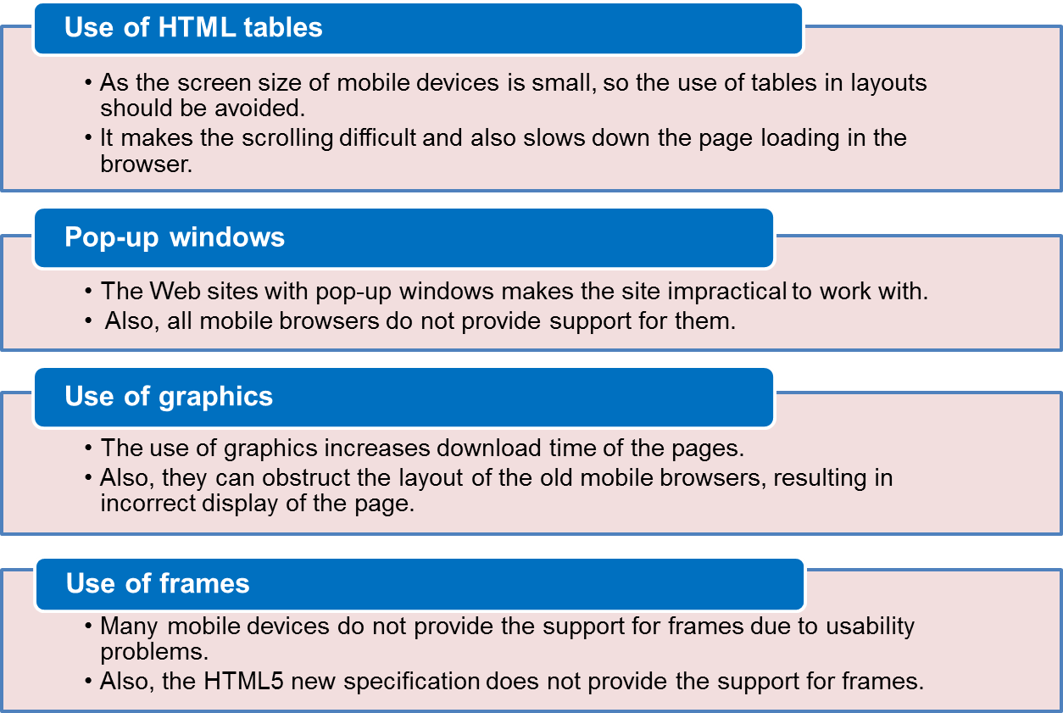
Architectural Aspects 2-2
Use of Web Standards
The Web standards: HTML, CSS, and JavaScript …must be correctly used. This increases the possibility of displaying pages on large number of devices.
The well-formedness of the markup tags used on a page can be achieved by validating them.

Slide 12
Setting Up the Environment 1-2
IDE
An IDE is a tool used for coding the markup, JavaScript, and CSS.
Some of these tools are as follows:
^{Adobe Dreamweaver}
^{Microsoft Expression Web}
^{Aptana Studio}
^{Eclipse}
^{Editplus (text editor)}
Emulators
^{Android}
^{iOS}
^{webOS}
^{Blackberry}
^{Windows Phone}
^{Opera Mobile}

Slide 13
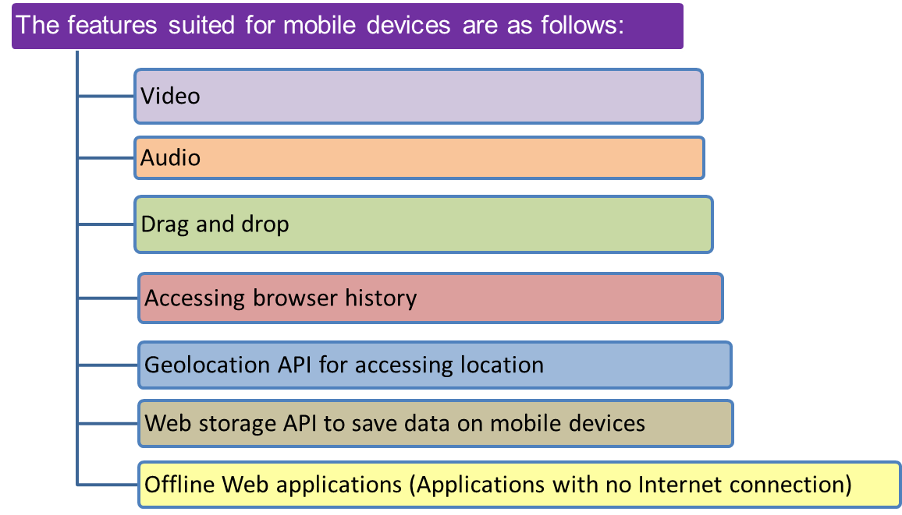
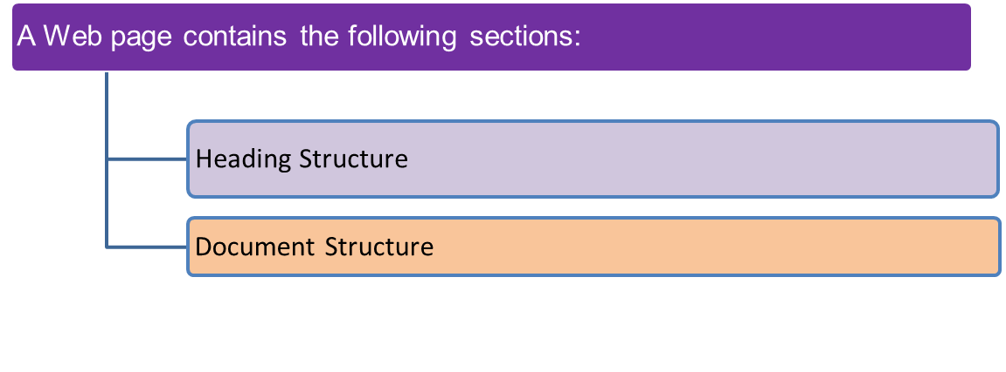
HTML Support on Mobiles
Today, majority of smartphones and tablets are providing good support for HTML5.
Most Android and iOS mobile devices as well as tablets use browsers that are based on Webkit.
The Webkit is a layout engine supported by browsers, such as Google Chrome and Apple Safari to render Web pages.
^{HTML} Makup:The Web pages developed for a mobile Web application have the same structure as traditional Web pages.

Slide 14
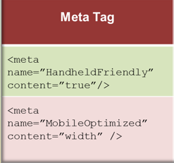
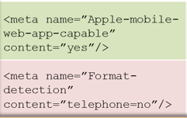
Heading Structure 1-3
Meta Tag
A <meta> tag indicate that the document is optimized for mobile devices and are used to control the display scale, while displaying HTML content on the device.
It is specific to mobile browsers.
^{Attribute}
^{width}
^{height}
^{initial-scale}

Slide 15
Heading Structure 2-3
Viewport Meta Tag
^{Attribute}
^{width}
^{height}
^{initial-scale}
This is a new technique used to inform the browser that the Web page is optimized for a mobile device.
A viewport is the rectangular display area on the screen, where the content of a Web page are displayed by the browser.
It contains attributes, such as width and height that can be set to larger or smaller values depending on the total visible area on the screen.
Following table lists the attributes of viewport meta tag.
^{minimum-scale}
^{maximum-scale}
^{user-scalable}

Slide 16
Heading Structure 3-3
Title Tag
Apart from <meta> tag, <head> element also contains a <title> tag.
The text selected for <title> tag should be meaningful, short, and precise.
It should be between four and eight words, as some old mobile devices truncate the long titles after 10 or 12 words.
Icons
To add icons to a mobile Web page, images in or format could be used.
These formats are compatible with mobile devices, as they are easy to export and are optimized in size.
^{For example,}
<link rel=”icon” type=”image/png” href=”mobile.png” />
From HTML5 onwards, Android supports the apple-touch-icon-precomposed meta tag in order to display high-resolution icons.

Slide 17
Document Structure 1-3
The document structure is represented by a <body> element in the HTML Web page.
The <body> element of a mobile Web application defines the content that are displayed to the user.
Some of the elements used in the <body> element of a mobile Web page are as follows:
Layouts
The HTML5 new tags that provide semantics for the layout of an HTML document are as follows:
<article> - An independent portion of the document or site
<aside> - Content that is tangential to the main part of the page or site
<figcaption> - Caption for a figure
<figure> - A figure or quotation pulled out of the flow of text
<footer> - The footer of a document or section
<header> - The header of a document or section
^{<hgroup> - A group of headings}
^{<nav> - A navigation section}
<section> - Identifies a block of content

Slide 18
Document Structure 2-3
Images
Images can be used in mobile Web applications for pictorial representation.
Almost all mobile browsers understand formats, such as GIF, JPEG, and PNG.
The <img> tag is used to display image on a Web page.
The attributes of <img> tag, such as width, height, and alt should be specified, as it reduces the rendering time of the image.
Lists
Ordered lists
Used for navigational menus and are defined using <ol> tag on a Web page.
Definition lists
Unordered lists
Used for presenting objects of same type and are defined using <ul> tag on a Web page.
Used for presenting information as key/value pairs and are defined using <dl> tag on a Web page.

Slide 19
Document Structure 3-3
Links
Hyperlinks are used to link pages in a Web application.
A hyperlink is defined using <a> tag with href attribute.
The href attribute is set to the URL of a resource.
The <a> tag should also have accesskey attribute specified with it.
The accesskey attribute is a keyboard shortcut and is useful for mobile devices that have support for access keys.
As mobile devices are basically phones, hence, links can be created to perform phone call actions.
This is achieved using the tel:<phone number> scheme embedded with a hyperlink.

Slide 20
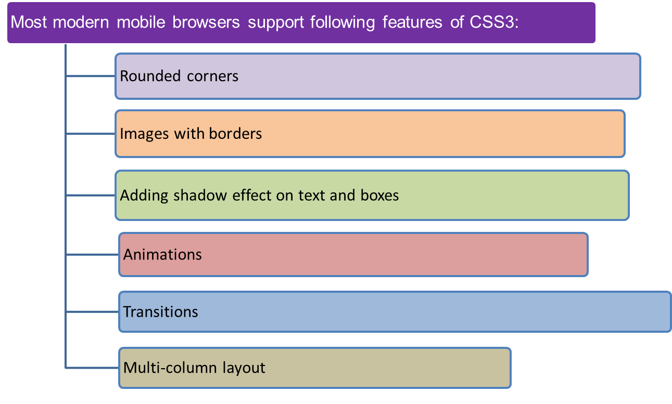
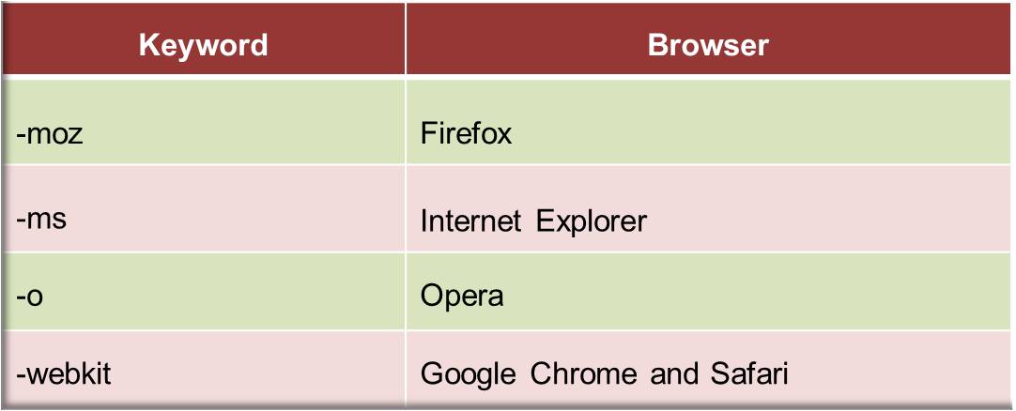
CSS for Mobile 1-3
CSS3 provides properties for adding colors, selectors, borders, backgrounds, and so on for effective appearance of a Web page.

Slide 21
CSS for Mobile 2-3
Media Queries for Browser Detection
Media queries are used to target specific features, such as screen width, orientation, and resolution of the devices.
The use of a media query is to display HTML pages on various devices, such as computers and mobile devices with different styles based on their media types.
In media queries, expressions are added for specific media type, then checking for condition is done, and finally, respective style sheet is applied to a Web page.
Media queries are used in two ways that are as follows:
Inline within a CSS style sheet
In the <link> tag as “media” attribute

Slide 22
CSS for Mobile 3-3
The Code Snippet shows the markup to apply a style sheet named screen.css to a device with screen and set the viewing-width of the area to 480.
<link type=”text/css” rel=”stylesheet” media=”only screen and
(max-device-width: 480px)” href=”screen.css” />
The Code Snippet shows the code to change the background color of a Web page depending on the device width.
@media only screen and (max-device-width: 480px) {
^{body {}
^{background-color: #666;}
}}
The Code Snippet shows the markups to serve style sheets based on the orientation of the device.
<link rel=”stylesheet” media=”all and (orientation: portrait)”
href=”portrait_orientation.css” />
<link rel=”stylesheet” media=”all and (orientation: landscape)”
href=”landscape_orientation.css” />

Slide 23
Optimizing a Site for a Mobile 1-2
Mobile Web sites should be optimized for better performance.
Some of the best practices that can be followed for mobile applications are as follows:
Design of a mobile Web site should be simple to fit on small screens.
Avoid horizontal scrolling as some phones do not support horizontal scrolling and hide the content on the screen.
Use buttons, instead of providing many tiny links, as this can annoy the mobile users.
Create cookies to store the user’s choice for viewing the full version of the site.
Avoid creating complex forms with many input fields, as data entry can be difficult on mobile devices compared to the desktops.
Limit the use of images due to bandwidth restrictions on mobile devices.

Slide 24
Optimizing a Site for a Mobile 2-2
Add mobile specific functionalities, such as built-in GPS facility or call-in action links.
Use of good foreground and background colors is important as they makes the sites readable on small screens.
Select the technologies that are compatible with old mobile devices.
Also, provide alternatives for functionalities, such as cookies, tables, style sheets, fonts, colors, and so on.
Avoid use of pop-up windows, tables for layout, frames, and image maps in the mobile Web site design.

Slide 25
Summary
A mobile device is a small portable computing device with a small display screen and keyboard.
The different categories of mobile devices available in the market are: basic model, low-end mobile devices, mid-end mobile devices, high-end mobile devices, smartphones, and tablets.
A mobile platform is basically responsible to interact with the device hardware and run software/services on the mobile device.
Different platforms for mobile devices include: Palm OS, Blackberry, iOS, Symbian, Windows Mobile, and Android.
An ideal mobile Web site is supported and rendered properly by maximum possible browsers and OS.
Two factors that need to be considered, while designing mobile Web application are its initial display (zoom) scale and orientation.
The use of media query is to display HTML pages on different devices with different styles based on their media types.

